Slide 1
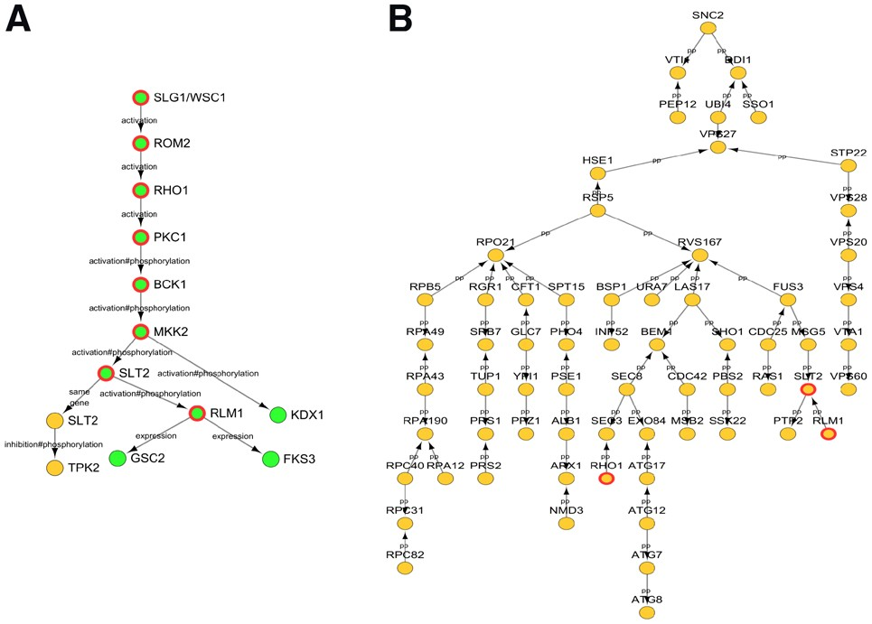

Fig. 4. The cell wall stress response in S.cerevisiae pathway predicted by IMPRes in (A) and SteinerNet in (B). (A) ...
Notes:
Fig. 4. The cell wall stress response in S.cerevisiae pathway predicted by IMPRes in (A) and SteinerNet in (B). (A) The nodes are colored based on their pathway. Green is pathway ‘MAPK signaling pathway – yeast’. Yellow is pathway ‘Autophagy – yeast’. Edges are labeled with annotations in KEGG. Red circled genes are genes participate in CWI pathway. (B) Node color does not have meaning in SteinerNet result. Red circled genes are genes participate in CWI pathway. All edges are from protein–protein interactions
Unless provided in the caption above, the following copyright applies to the content of this slide: © The Author(s) 2019. Published by Oxford University Press. All rights reserved. For permissions, please e-mail: journals.permissions@oup.comThis article is published and distributed under the terms of the Oxford University Press, Standard Journals Publication Model (https://academic.oup.com/journals/pages/open_access/funder_policies/chorus/standard_publication_model)

